Slide 1
FashionFinder: Efficient Clothing Retrieval with Deep
Features and Vocabulary Trees
Om Mali,
Naga Kushal Ageeru

Slide 2
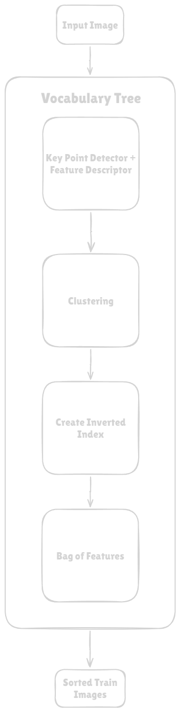
Problem Statement:
We aim to build a CBIR system using a vocabulary tree to address the challenges of large-scale image retrieval, such as high computation time and storage demands. The vocabulary tree's hierarchical structure and efficient feature organization ensure faster and scalable retrieval .
Approach :
- Advanced Feature Extraction : The approach integrates various feature extraction techniques to capture distinctive and reliable characteristics of garment images. These methods include not only traditional standalone feature descriptors but also leverage pre trained neural network weights to generate feature detectors from keypoints, enhancing the feature extraction process.
- Vocabulary Tree Structure : Organizes the extracted features into a hierarchical structure for efficient and scalable image retrieval.
- Optimized Retrieval : Balances retrieval accuracy and computational efficiency, making the system suitable for large-scale garment image searches.
- Fast Retrieval : Uses compact representations in the vocabulary tree to enable quick feature matching against stored data for accurate image recommendations.
Data :
Dataset contains around 1,100 high-resolution garment images of various types, colors, and designs.1,000 images are used for training and experimentation, with the rest reserved for testing.
Images are categorized by garment type and color, facilitating targeted retrieval tasks.

Slide 3
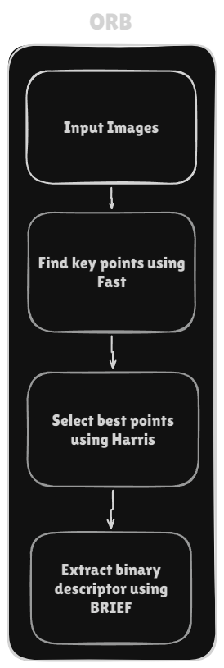
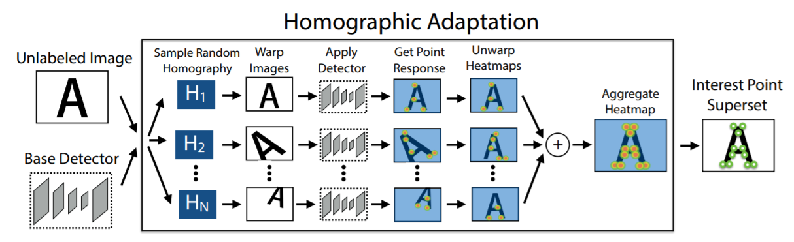
Problem Statement:
Baseline: ORB
SIFT - Using Opponent Colour Spaces
ORB with three color channels
ORB + Resnet
SuperPoint
Problem Statement:
Mean Average
Precision (MAP)
Normalized Discounted Cumulative Gain (nDCG)

Slide 4
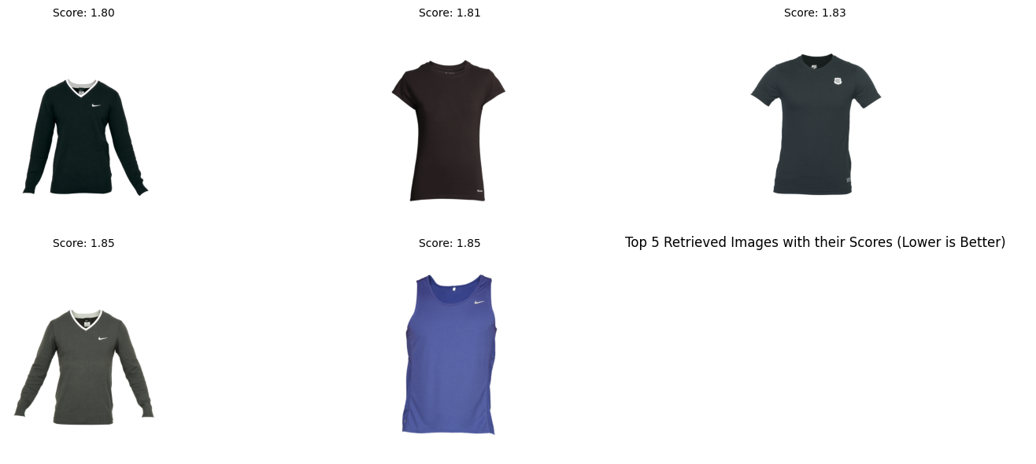
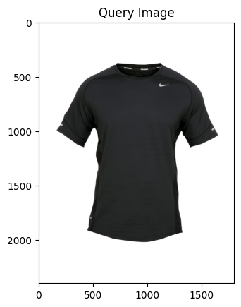
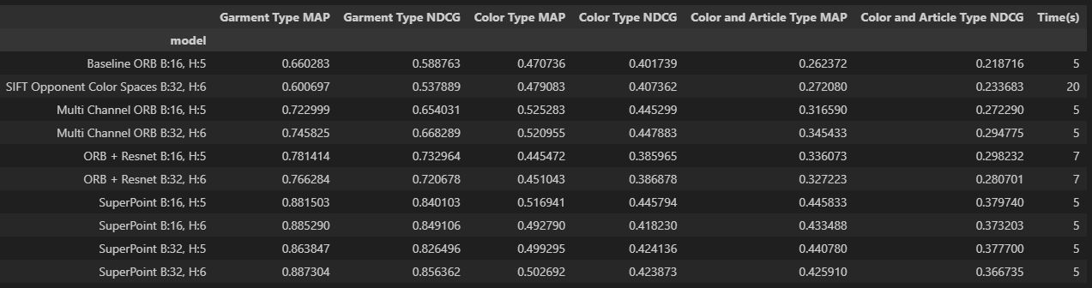
Results
Sorted Images / Recommendations
Input Image

